Slide 1
Publications
Analysis of nocturnal actigraphic sleep measures in patients with COPD and their association with daytime physical activity.
Spina G et al., Thorax Jan 2017.
NS Approval ID 1033338 Revision Date 02/2017
Prices and SmPC available upon request via your medical representative

Slide 2
Context
Methods
Results
Conclusion
Discussion
Duaklir Genuair

Slide 3
Sleep disturbance in COPD: a forgotten dimension with important consequences?
CONTEXT
Although maintaining physical activity is key in COPD management, factors associated with patients’ capability to engage in physical activity are not well established^{1,2}.
Despite the high prevalence of disturbed sleep in COPD, night-time symptoms are often underestimated and are not a focus of current COPD management^{1,3}.
Factors associated with measures of sleep in daily life nor the association between sleep and the ability to engage in physical activity have been investigated before¹.
Spina et al., Thorax. 2017; 0: 1-8. doi: 10.1136/thoraxjnl-2016-208900
Gimeno-Santos et al., Thorax. 2014; 69: 731-9
Agusti et al., Eur Respir Rev. 2011; 20: 183-94

Slide 4
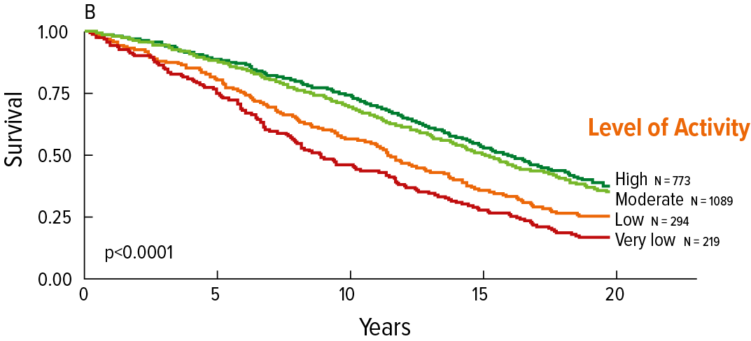
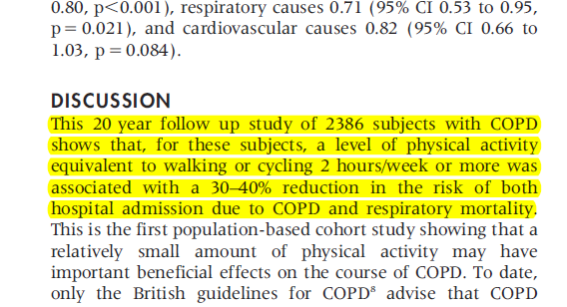
Regular physical activity reduces the risk of mortality and hospital admissions¹
CONTEXT
Kaplan-Meier curve of time to death (all-cause mortality) according to level of regular physical activity
Adapted from Garcia-Aymerich et al., 2006
1. Garcia-Aymerich et al., Thorax. 2006; 61: 772-778

Slide 5
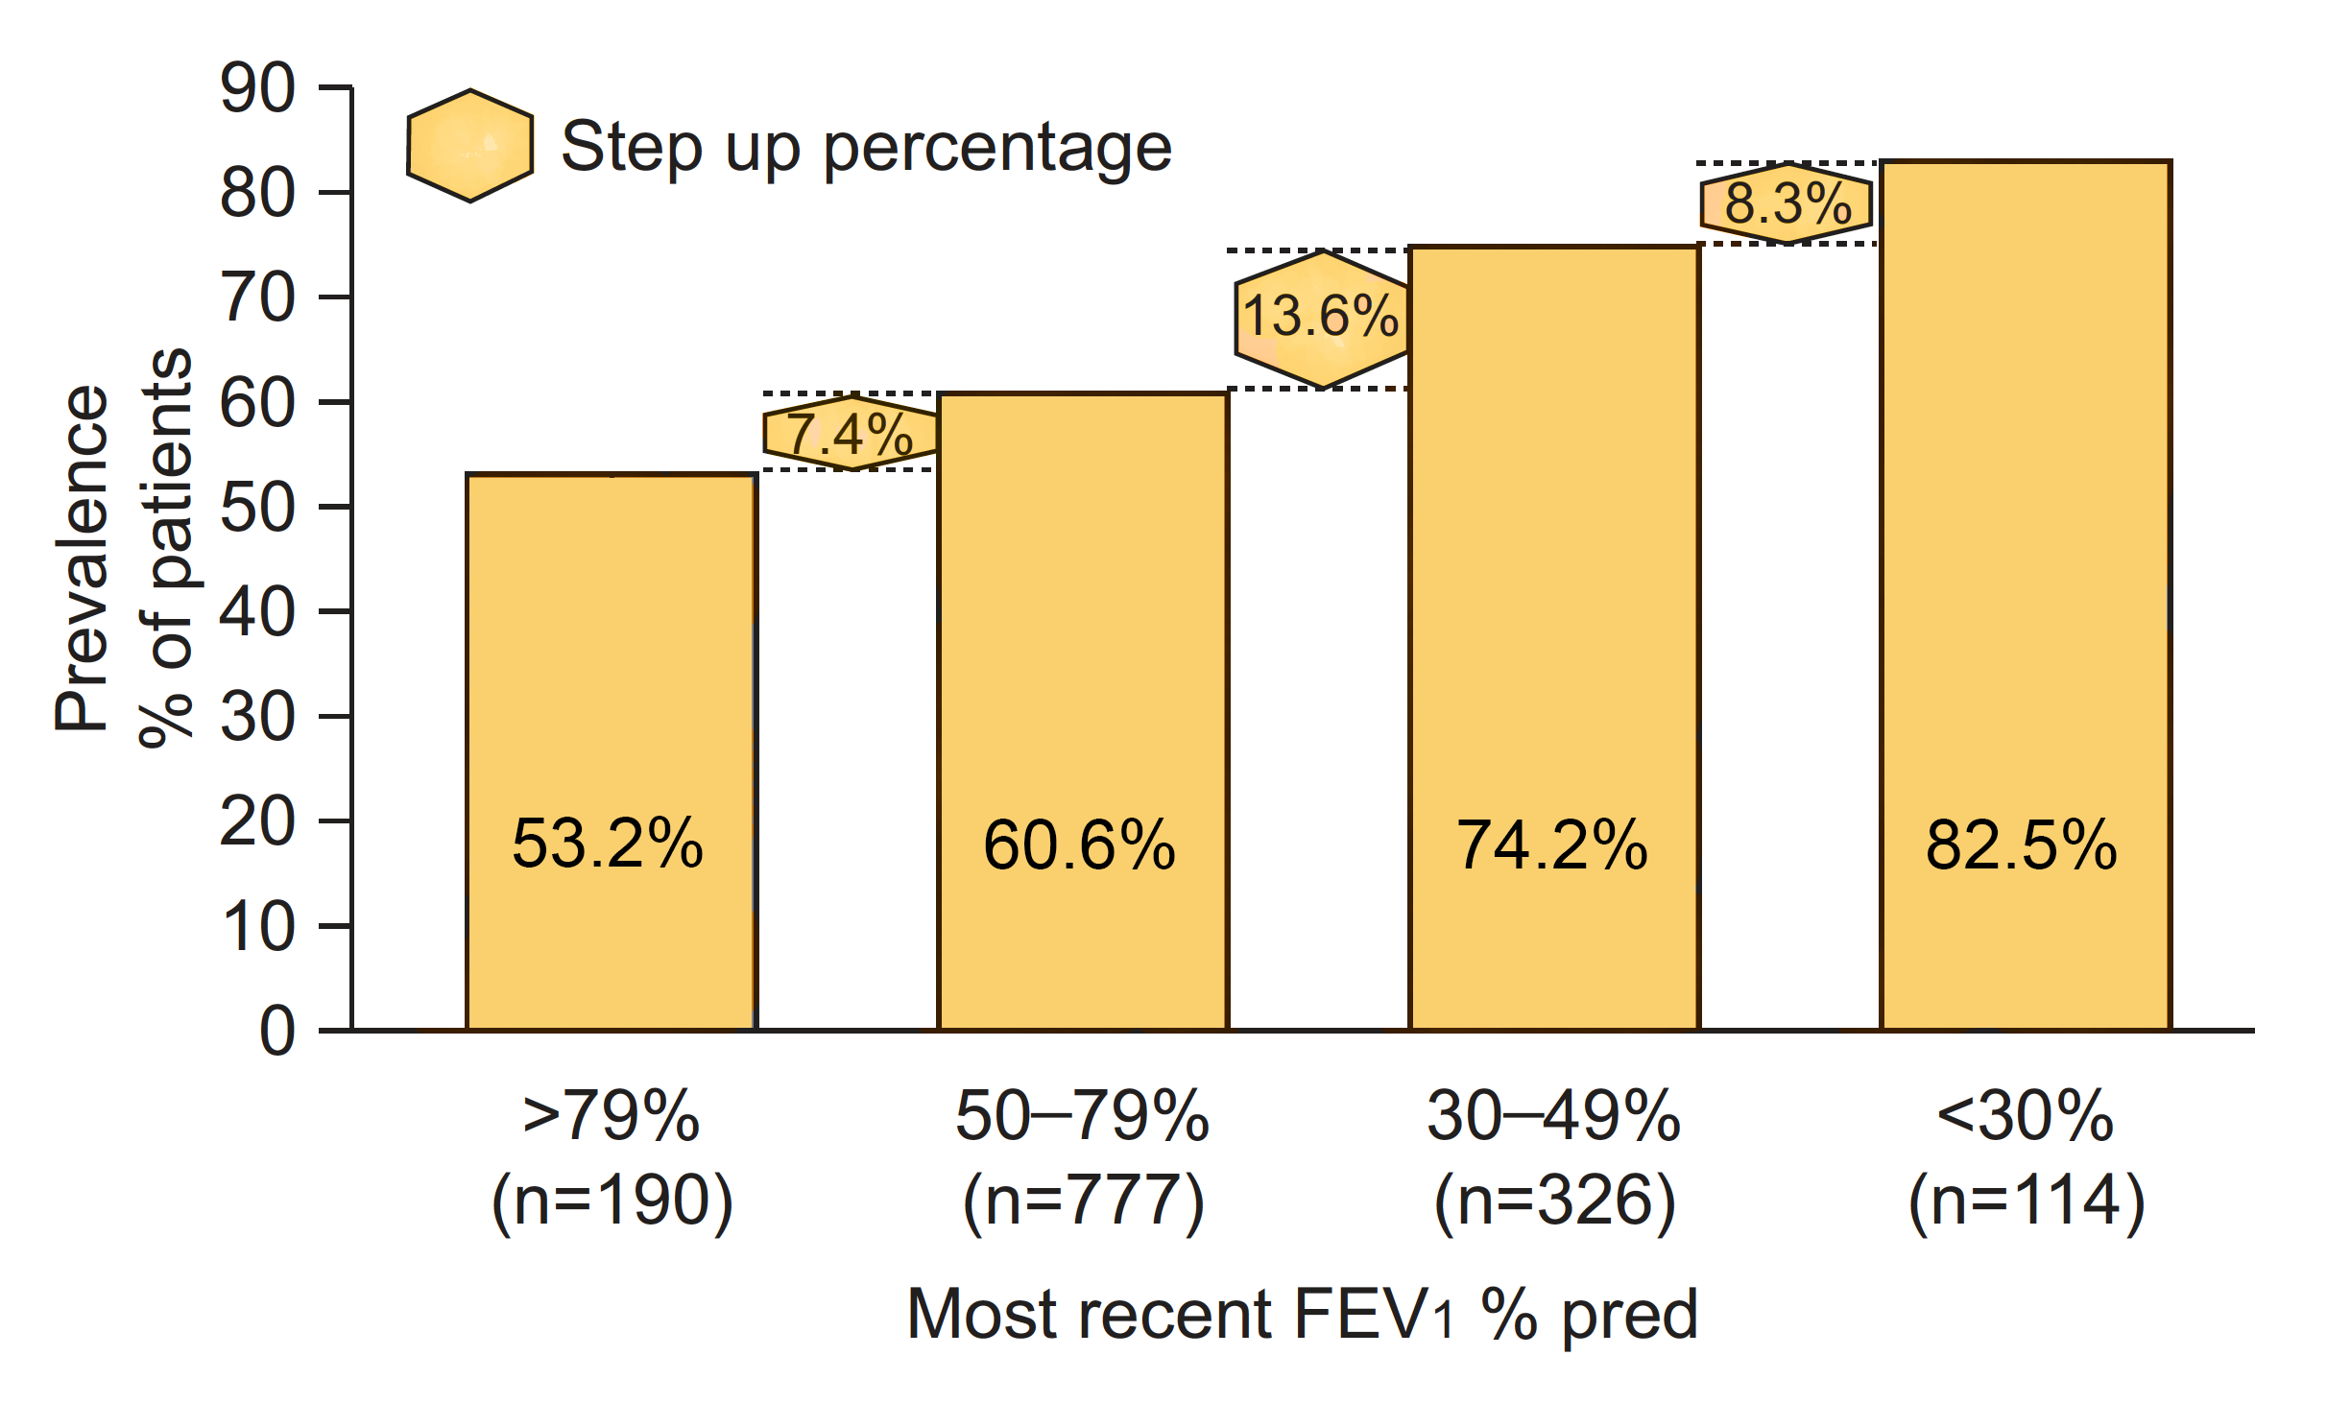
There is a high prevalence of sleep disturbance in COPD¹
CONTEXT
Prevalence of night-time symptoms in patients with COPD stratified by FEV1 %
1. Agusti et al., Eur Respir Rev. 2011; 20: 183-94

Slide 6
Study Objective¹
CONTEXT
Sleep disturbances are common in COPD with a considerable impact on quality of life. However, factors associated with measures of sleep or the association between sleep and the ability to engage in physical activity have not been investigated before.
This study aims to
provide insights into the relationship between actigraphic sleep measures and disease severity, dyspnoea, gender and parts of the week.
investigate the association between sleep measures and next day physical activity.
1. Spina et al., Thorax. 2017; 0: 1-8. doi: 10.1136/thoraxjnl-2016-208900

Slide 7
Context
Methods
Results
Conclusion
Discussion
Duaklir Genuair

Slide 8
Study design¹
METHODS
In this retrospective, cross-sectional study, data from previous studies were obtained from research groups in 10 countries: Europe (the Netherlands, the UK, Switzerland, Germany, Italy, Ireland and Spain), North America, South America and Oceania.
Inclusion criteria were stable COPD, post-bronchodilator ratio FEV1 to FVC <0.70; no COPD exacerbations in the last 30 days; and availability of sleep and daytime physical activity data baseline data recorded in daily life using the SenseWear Armband or SenseWear Mini Armband. Participants had sleep and physical activity continuously monitored using a multisensory activity monitor for a median of 6 days.
1. Spina et al., Thorax. 2017; 0: 1-8. doi: 10.1136/thoraxjnl-2016-208900

Slide 9
Flow of patients through the study¹
METHODS
Data from 1.384 patients were available. In total 932 COPD patients were eligible for analysis.
Patients with COPD assessed for eligibility (n=1384)
Excluded (n=316)
• Night time data not present or corrupted (n=141)
• Not enough weekends (n=147)
• Not enough weekdays (n=28)
Excluded (n=136)
· Irregular sleeping pattern (n=17)
· Time in bed<4 hours (n=119)
Patients with COPD analysed (n=932)
1. Spina et al., Thorax. 2017; 0: 1-8. doi: 10.1136/thoraxjnl-2016-208900

Slide 10
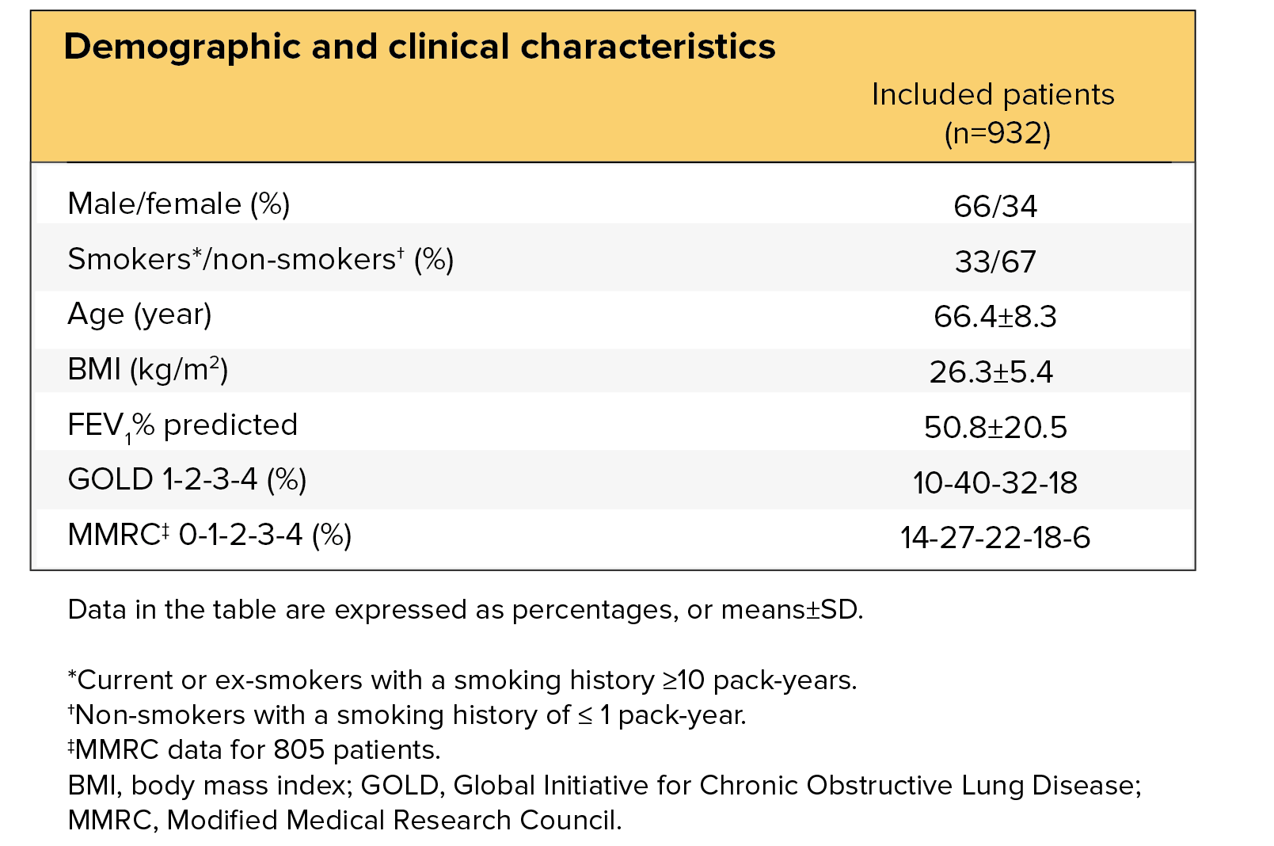
Patient Demographics¹
METHODS
1. Spina et al., Thorax. 2017; 0: 1-8. doi: 10.1136/thoraxjnl-2016-208900

Slide 11
Context
Methods
Results
Conclusion
Discussion
Duaklir Genuair

Slide 12
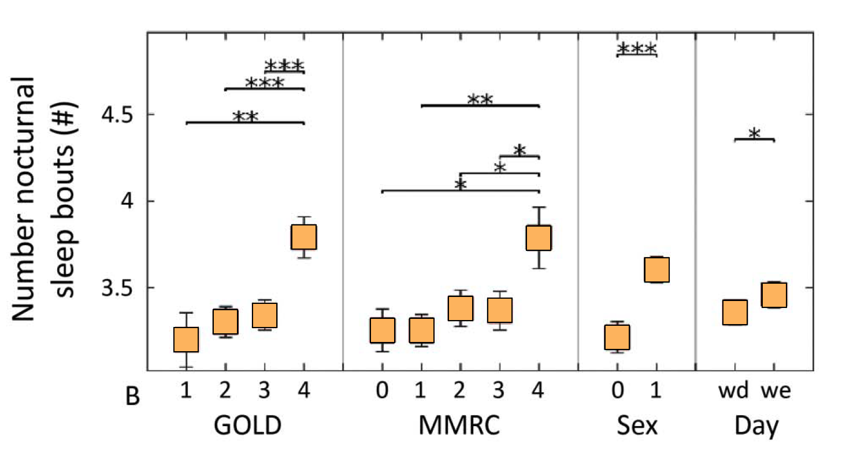
Patients with the most severe airflow limitation & exertional dyspnoea have significantly more fragmented sleep than patients with the lowest GOLD grade (p<0.01) and mMRC score (p<0.05)¹
RESULTS
Sleep measures evaluation in patients with COPD
Number of nocturnal sleeping bouts
Impact of disease severity according to the Global Initiative for Chronic Obstructive Lung Disease (GOLD) grades, daytime dyspnoea according to the Modified Medical Research Council (MMRC) scale, sex (0=female, 1=male), and parts of the week (wd=weekdays, we=weekends)on sleep parameters. Data are expressed as least-square means±SE. Significance levels for pairwise comparisons are indicated as horizontal bars with *p<0.05, **p<0.01 and ***p<0.001.
1. Spina et al., Thorax. 2017; 0: 1-8. doi: 10.1136/thoraxjnl-2016-208900

Slide 13
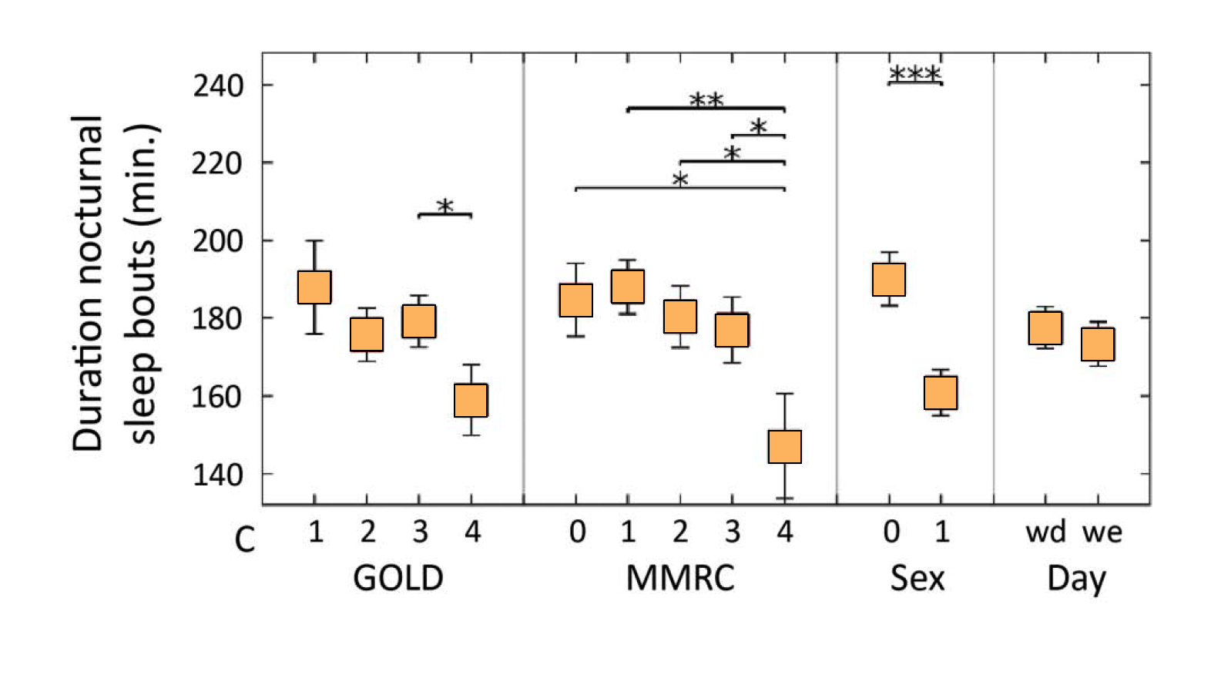
Patients with the most severe airflow limitation and reporting the highest mMRC score have significantly shorter sleeping bouts (p<0.05 for all)¹
RESULTS
Sleep measures evaluation in patients with COPD
Average duration of nocturnal sleeping bouts
Impact of disease severity according to the Global Initiative for Chronic Obstructive Lung Disease (GOLD) grades, daytime dyspnoea
according to the Modified Medical Research Council (MMRC) scale, sex (0=female, 1=male), and parts of the week (wd=weekdays, we=weekends)
on sleep parameters. Data are expressed as least-square means±SE. Significance levels for pairwise comparisons are indicated as horizontal bars
with *p<0.05, **p<0.01 and ***p<0.001.
1. Spina et al., Thorax. 2017; 0: 1-8. doi: 10.1136/thoraxjnl-2016-208900

Slide 14
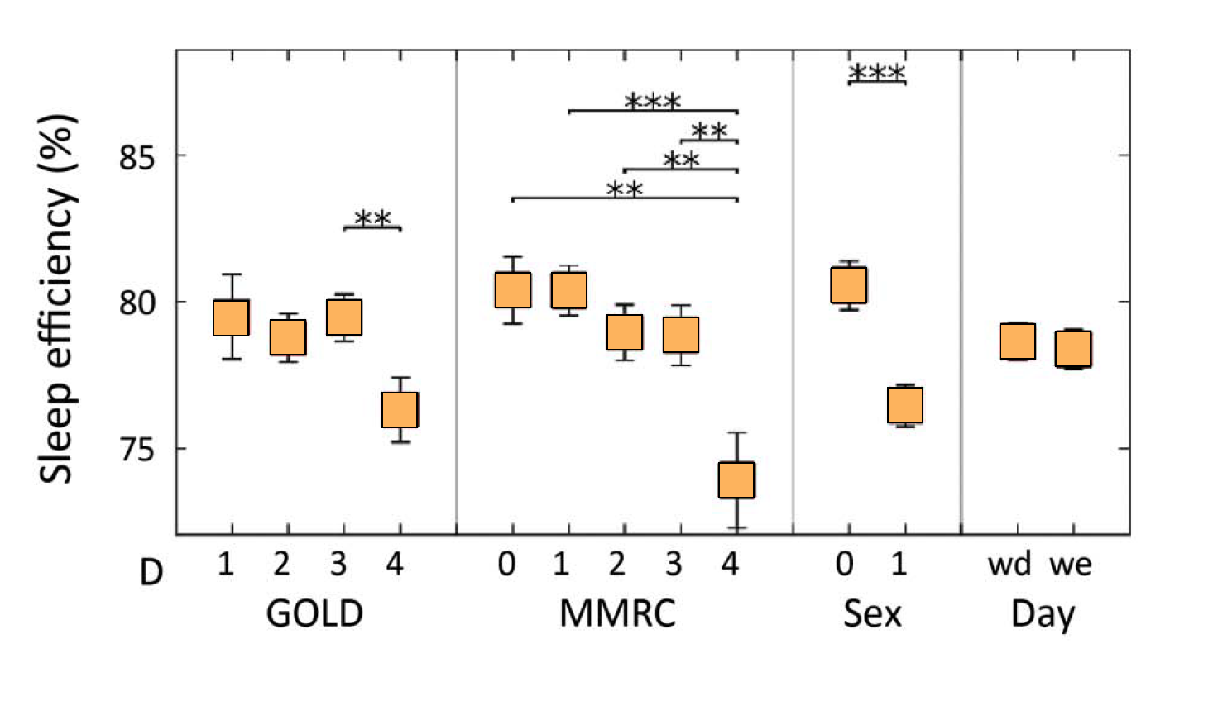
Patients with the most severe airflow limitation and reporting the highest mMRC score have significantly lower sleep efficiency (p<0.01 for all)¹
RESULTS
Sleep measures evaluation in patients with COPD
Sleep efficiency
Sleep efficiency is defined as
the ratio of total night sleeping time and time in bed
Impact of disease severity according to the Global Initiative for Chronic Obstructive Lung Disease (GOLD) grades, daytime dyspnoea
according to the Modified Medical Research Council (MMRC) scale, sex (0=female, 1=male), and parts of the week (wd=weekdays, we=weekends)
on sleep parameters. Data are expressed as least-square means±SE. Significance levels for pairwise comparisons are indicated as horizontal bars
with *p<0.05, **p<0.01 and ***p<0.001.
1. Spina et al., Thorax. 2017; 0: 1-8. doi: 10.1136/thoraxjnl-2016-208900

Slide 15
The number of steps performed during the day increased as the duration of sleeping bouts and the sleep efficiency increased.¹
RESULTS
Association between sleep measures & daytime physical activity
Nocturnal sleep measures were divided into quartiles
(Q1 = shortest/lowest Q4 = longest/highest)
Association between nocturnal sleep parameters (total night sleeping time; number of nocturnal sleeping bouts; average duration of nocturnal sleep bouts; sleep efficiency; time awake after the first sleep onset) and daytime physical activity: STEP=steps performed. Data are expressed as least-square means±SE. Significance levels for pairwise comparisons are indicated as horizontal bars with *p<0.05, **p<0.01 and ***p<0.001. TIME VL, TIME L and TIME MV are presented in % of the out of bed time.
1. Spina et al., Thorax. 2017; 0: 1-8. doi: 10.1136/thoraxjnl-2016-208900

Slide 16
Patients with the smallest number of sleeping bouts, longest sleeping bouts and highest sleep efficiency spent more time in moderate-to-vigorous activities on the following day¹
RESULTS
Association between sleep measures & daytime physical activity
Nocturnal sleep measures were divided into quartiles
(Q1 = shortest/lowest Q4 = longest/highest)
Association between nocturnal sleep parameters (total night sleeping time; number of nocturnal sleeping bouts; average duration of
nocturnal sleep bouts; sleep efficiency; time awake after the first sleep onset) and daytime physical activity: TIME MV=time spent in moderate-to-vigorous activity. Data are expressed as least-square means±SE. Significance levels for pairwise comparisons are indicated as horizontal bars with *p<0.05, **p<0.01 and ***p<0.001. TIME VL, TIME L and TIME MV are presented in % of the out of bed time.
1. Spina et al., Thorax. 2017; 0: 1-8. doi: 10.1136/thoraxjnl-2016-208900

Slide 17
Context
Methods
Results
Conclusion
Discussion
Duaklir Genuair

Slide 18
Poor sleep may hamper efforts of COPD patients to be physically active¹
CONCLUSION
Sleep impairment in COPD patients tends to be more pronounced in patients with severe airflow limitation and with worse exertional dyspnoea.
Moreover, nocturnal sleep impairment appears to be an important factor associated with the capability to engage in physical activity on a day-to-day basis.
The fact that poor sleep quality was associated with reduced physical activity levels may have important consequences with regard to current clinical practice.
1. Spina et al., Thorax. 2017; 0: 1-8. doi: 10.1136/thoraxjnl-2016-208900

Slide 19
Consequences with regard to current clinical practice¹
CONCLUSION
Findings suggest the possibility of increasing spontaneous engagement in physical activity through improving sleep.
Existing strategies for promoting physical activity tend to focus on actions during the day. Efforts promoting sleep quality may increase the overall impact of these interventions.
Sleep should be assessed and taken into account when analysing physical activity in COPD.
1. Spina et al., Thorax. 2017; 0: 1-8. doi: 10.1136/thoraxjnl-2016-208900

Slide 20
Context
Methods
Results
Concluions
Discussion
Duaklir Genuair

Slide 21
Symptoms limit COPD patient’s physical activities, even early in the disease, leading to a worse prognosis¹⁻⁵
DISCUSSION
Patients suffer from breathlessness during activities⁶
Patients limit their activities to avoid symptoms⁶
Deconditioning aggravates symptoms⁶
Increase of hospital admissions and mortality³
Jones et al., Int J Chron Obstruct Pulmon Dis. 2016; 11(Spec ISS): 13-20
Troosters et al., Respir Res. 2013; 14(1): 115
Garcia-Aymerich et al., Thorax. 2006; 61: 772-778
Watz et al., Eur Respir J. 2009; 33: 262-272
Shrikrishna et al., Eur Respir J. 2012; 40: 1115-1122
Reardon et al., Am J Med. 2006; 119(10 suppl 1):32-37

Slide 22
COPD patients suffer most from symptoms during morning, evening and night-time¹
DISCUSSION
1. Partridge MR et al., Curr Med Opnin 209; 25: 2043-348

Slide 23
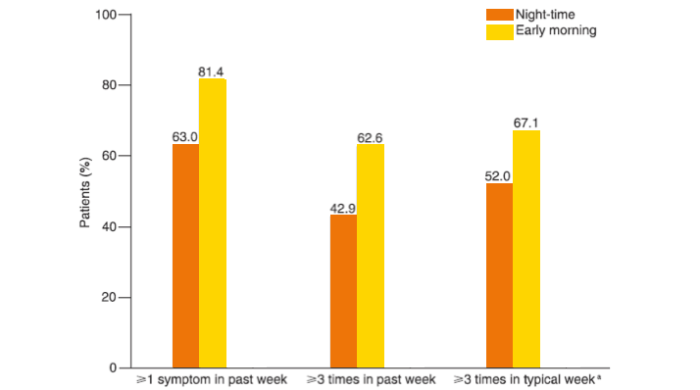
63% experienced at least 1 night-time symptom, 52% reported night-time symptoms at least 3 times in the week before baseline¹
DISCUSSION
Prevalence of individual COPD symptoms throughout the 24-hour day in the week before baseline (N = 727). COPD, Chronic obstructive pulmonary disease
1. Miravitlles et al., Resp Res. 2014; 15: 122

Slide 24
Coughing, bringing up phlegm or mucus and breathlessness are most reported symptoms during night-time.¹
DISCUSSION
Prevalence of individual COPD symptoms throughout the 24-hour day in the week before baseline (N = 727). COPD, Chronic obstructive pulmonary disease
1. Miravitlles et al., Resp Res. 2014; 15: 122

Slide 25
Night-time dyspnoea is associated with a worse prognosis¹
DISCUSSION
100
n=687
100
n=359
100
n=591
80
80
80
60
60
60
Free of COPD Hospital admissions (%)
Survival (%)
Free of exacerbations (%)
P=0.004
P<0.001
P<0.001
40
40
40
20
No night time dyspnoea
Night dyspnoea
20
No night time dyspnoea
Night dyspnoea
20
No night time dyspnoea
Night dyspnoea
0
1
2
3
4
5
0
1
2
3
4
5
0
1
2
3
4
5
Follow-up (years)
Follow-up (years)
Follow-up (years)
1. Lange P et al. Eur Respir J 2014;43:1590-1598

Slide 26
Several potential mechanisms could explain the association between sleep impairment with the most severe stage of the disease and dyspnoea¹
DISCUSSION
Lower Oxygen Saturation
It is intuitively apparent that because patients with severe COPD have a lower oxygen saturation during wakefulness, the normal ventilation changes that occur with sleep exacerbate this pre-existing state to the point of severity impairing sleep.
Reduction in Muscle Tone
The lying sleep position assumed by the participants in the study and the reduction in muscle tone causes increased upper airway resistance. This might have more impact in patients who are least able to tolerate any further challenge to their ventilatory capability.
Episodes of worsening symptoms
Patients with severe COPD frequently experience episodes of worsening symptoms that may also preclude from adequate sleep.
1. Spina et al., Thorax. 2017; 0: 1-8. doi: 10.1136/thoraxjnl-2016-208900

Slide 27
Context
Methods
Results
Conclusion
Discussion
Duaklir Genuair

Slide 28
Duaklir Genuair
DUAKLIR GENUAIR
Duaklir Genuair reduces breathlessness & overall symptoms during night time, early-morning and daytime^{1,2}
Duaklir Genuair reduces limitation of early-morning activities¹
Duaklir Genuair delays the time to the first moderate or severe exacerbation and reduces the rate of moderate of severe exacerbations^{1,2}
Bateman et al., Respir Res. 2015; 16(1): 92
SmPC Duaklir Genuair (340/12), latest edition
Duaklir is not indicated for sleep impairment

Slide 29
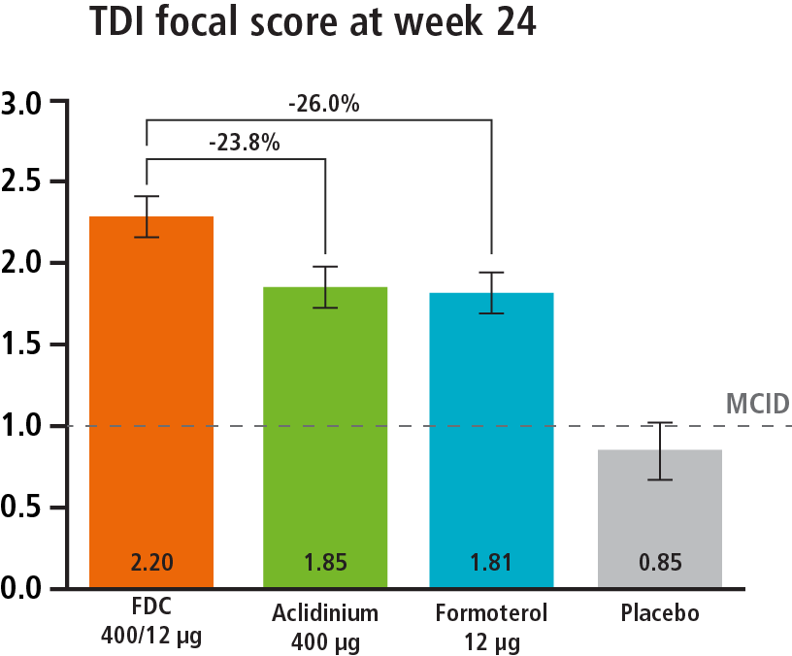
Duaklir® Genuair® significantly improves breathlessness versus mono-components, demonstrating this improvement night time, early-morning and daytime¹
DUAKLIR GENUAIR
Bateman et al., Respir Res. 2015; 16(1): 92
* Figure shows data on improvement of dyspnea during daytime

Slide 30
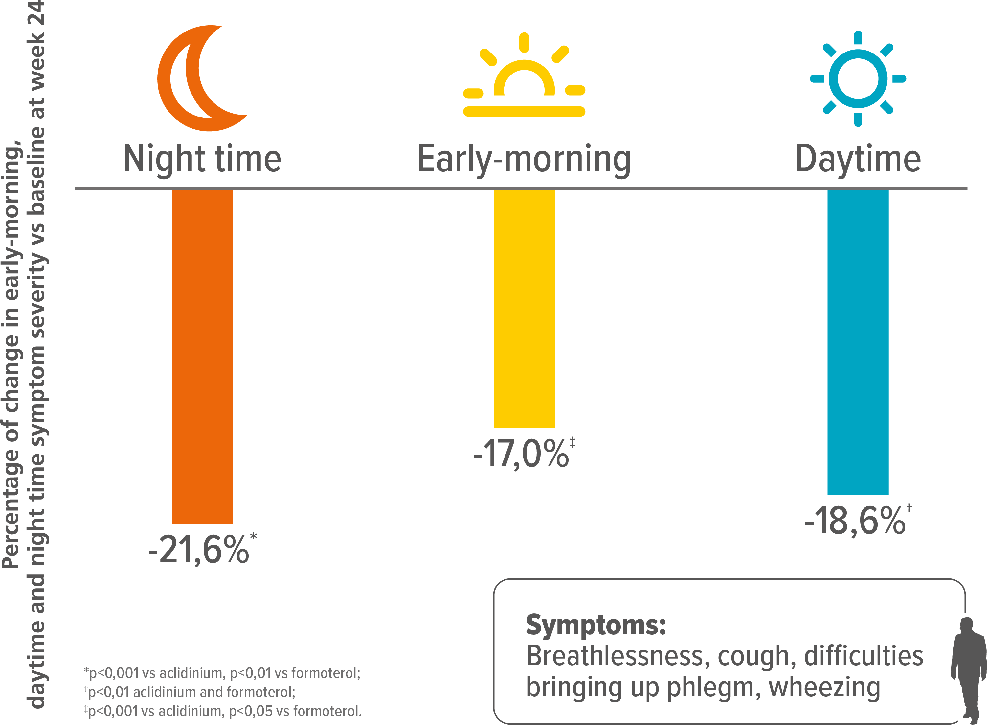
Duaklir® Genuair® significantly improves overall symptoms versus mono-components, demonstrating this improvement night time, early-morning and daytime¹
DUAKLIR GENUAIR
Bateman et al., Respir Res. 2015; 16(1): 92

Slide 31
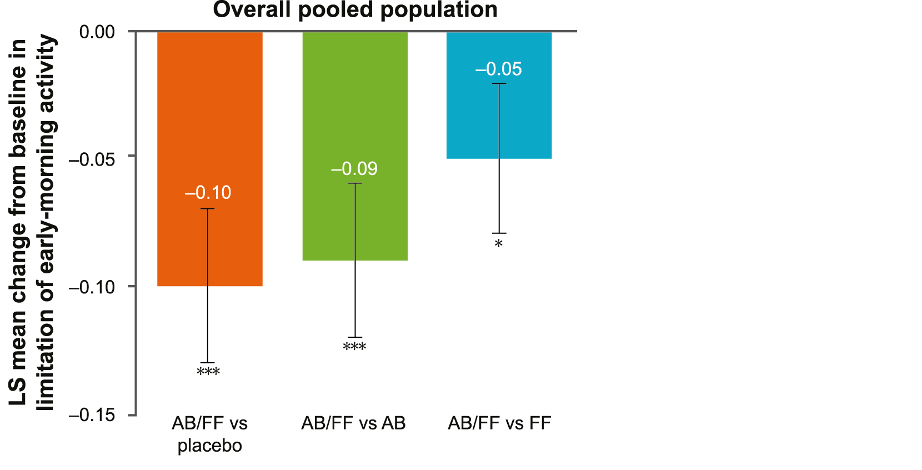
Duaklir® Genuair® significantly reduces the limitation of early-morning activities versus mono-components¹
DUAKLIR GENUAIR
Bateman et al., Respir Res. 2015; 16(1): 92

Slide 32
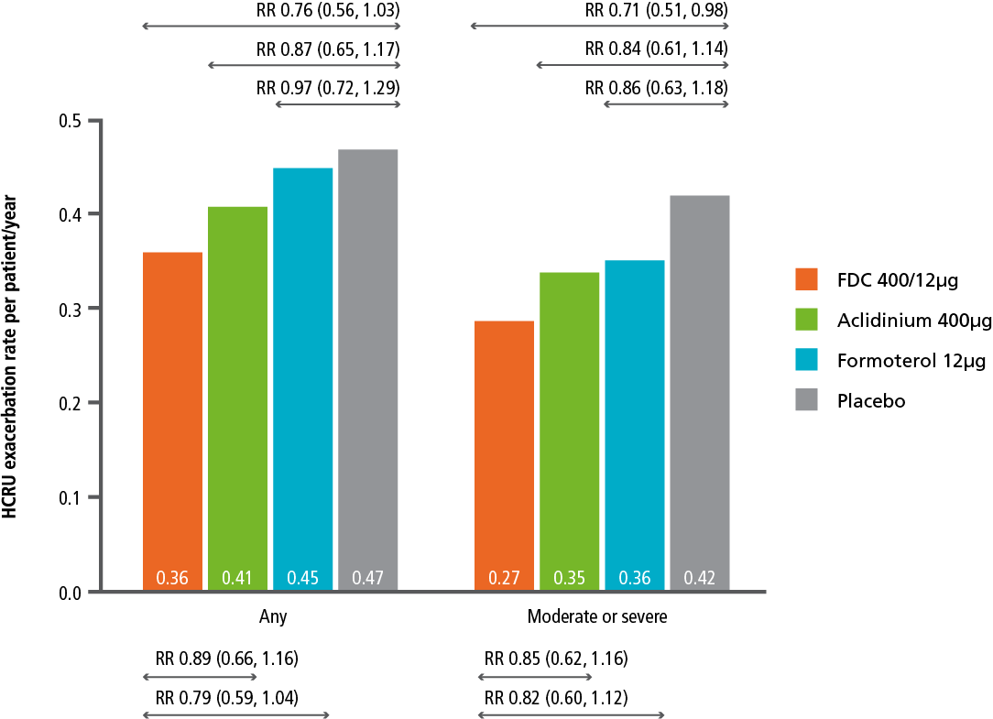
Duaklir® Genuair® delays the time to the first moderate or severe exacerbation and reduces the rate of moderate or severe exacerbations¹
DUAKLIR GENUAIR
Bateman et al., Respir Res. 2015; 16(1): 92
* Figure shows data on rate reduction

Slide 33
Want to be informed about
the latest scientific publications?
Subscribe to AZ Publication Alerts
Ask your rep for more information
NS Approval ID 1033338 Revision Date 02/2017

