Slide 1
Publications
Achieving asthma control with ICS/LABA: A review of strategies for asthma management and prevention.
Aalbers et al., Respir Med 2016.
NS ID XL-0208-RD12/2017-VA
Local code 1386
Prices and SmPC available upon request via your medical representative.

Slide 2
Context
The GOAL and FACET studies findings
Beyond GOAL and FACET
Airway remodelling
Conclusion
Discussion

Slide 3
The overall goal of an asthma treatment is the current control and the prevention of future risk¹
CONTEXT
Overall asthma control
ACHIEVING
REDUCING
Symptom control
Future risk
DEFINED BY
DEFINED BY
Symptoms
Reliever use
Instability/
worsening
Exacerbations
Activity
Lung function loss
Medication adverse effects
GINA 2017

Slide 4
In the GINA¹, two different treatments approaches are recommended as of stage 3
CONTEXT
GINA 2017

Slide 5
Review publication objective
CONTEXT
The goal of this publication was to review the role of ICS/LABA considering both current control and future risk with a focus on the maintenance and reliever approach.
It also explains how data from the budesonide/formoterol and beclometasone/formoterol maintenance and reliever therapy studies, in particular, expand upon the findings of both GOAL and FACET.

Slide 6
Context
The GOAL and FACET studies findings
Beyond GOAL and FACET
Airway remodelling
Conclusion
Discussion

Slide 7
Studies design
The GOAL and FACET studies findings
The GOAL and FACET studies findings
In the FACET study¹, patients who had stable asthma after a run-in period were randomised to receive budesonide (at a low or high dose) in combination with either formoterol or placebo. Patients were eligible for inclusion if they had been diagnosed with asthma for at least six months and had been treated with an ICS for at least three months, although patients receiving high doses of ICS at baseline were excluded.
In the GOAL study², patients were randomised to salmeterol/fluticasone or fluticasone. Patients were stratified by their pre-study ICS dose (stratum 1, no ICS; stratum 2, ≤ 500 µg of beclometasone dipropionate daily or equivalent; stratum 3, >500 µg to ≤1000 µg of beclometasone dipropionate daily or equivalent). The study was split into two phases; a dose-escalation phase followed by a phase during which patients remained on their maximum dose of treatment.
Pauwels et al. N Eng J Med 1997; 337:1405-1411
Bateman et al. Am. J. Respir. Crit. Care Med. 2004; 170: 836-844

Slide 8
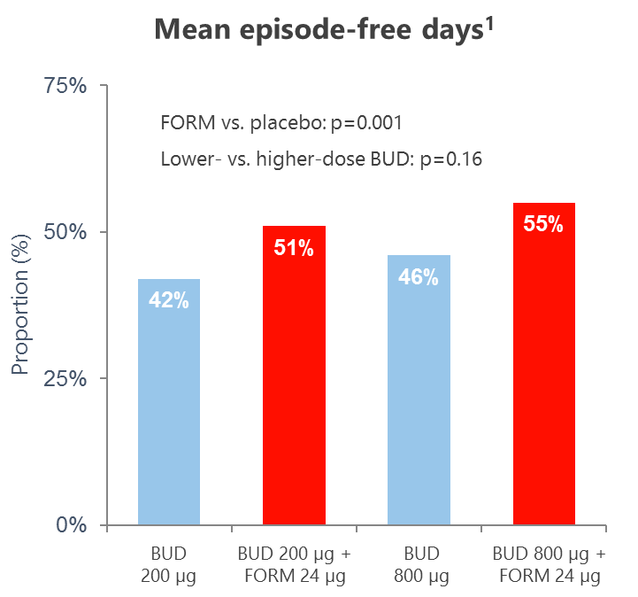
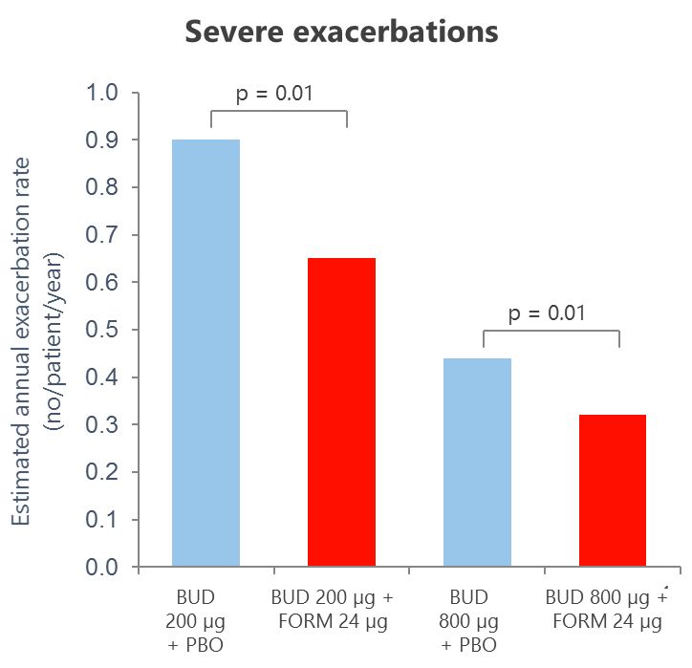
FACET Results¹
The GOAL and FACET studies findings
Current control
Future risk
Pauwels et al. N Eng J Med 1997; 337:1405-1411

Slide 9
GOAL Results¹
The GOAL and FACET studies findings
Current control
Future risk
Bateman et al. Am. J. Respir. Crit. Care Med. 2004; 170: 836-844

Slide 10
Discussion^{1,2}
The GOAL and FACET studies findings
Contrary to the FACET study, the GOAL study design meant that is was not possible to determine whether the addition of salmeterol to fluticasone was more beneficial than increasing the dose of fluticasone alone.
Interestingly though, in the GOAL study, many of these patients achieved total asthma control at the lowest dose of ICS. The results of this study therefore bring into question the benefits of increasing the maintenance dose of ICS until total control is achieved.
In particular, the STAY, COMPASS and AHEAD studies built on GOAL and FACET by comparing budesonide/formoterol maintenance and reliever therapy with two different doses of budesonide/formoterol plus SABA, budesonide plus SABA and salmeterol/fluticasone plus SABA.
Pauwels et al. N Eng J Med 1997; 337:1405-1411
Bateman et al. Am. J. Respir. Crit. Care Med. 2004; 170: 836-844

Slide 11
Context
The GOAL and FACET studies findings
Beyond GOAL and FACET
Airway remodelling
Conclusion
Discussion

Slide 12
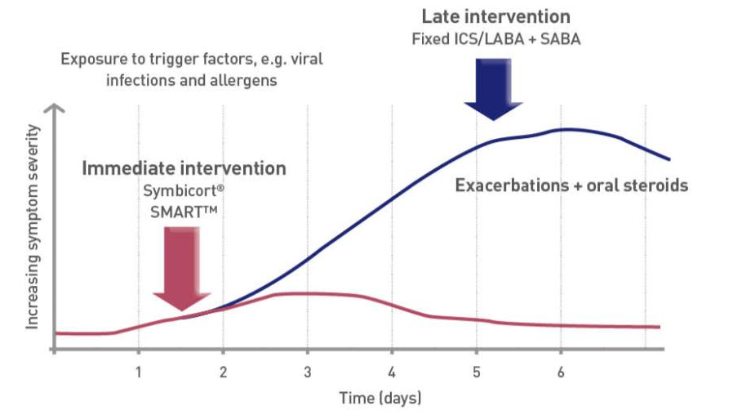
The use of budesonide/formoterol or beclometasone/formoterol maintenance and reliever therapy is recommended in GINA. By employing this treatment strategy, patients receive ICS in addition to a fast-acting bronchodilator whenever they require reliever medication, meaning that inflammation can be targeted when symptoms increase.
BEYOND GOAL & FACET
The Maintenance & Reliever approach
Adapted from Ankerst J et al. J Asthma 2005; 42: 715–24

Slide 13
BEYOND GOAL & FACET
The Maintenance & Reliever approach
The budesonide/formoterol maintenance & reliever approach has been studied in 6 randomized clinical trials (STEP, STEAM, STAY, SMILE, COMPASS, AHEAD) to compare it with all alternative standard treatment strategies in patients with moderate-to-severe asthma.
In addition to the studies mentioned above, the use of budesonide/formoterol as maintenance and reliever therapy has been assessed in over 23,000 patients as part of four real-world studies that included comparisons with salmeterol/fluticasone or conventional best practice and an evaluation of a range of doses.
In contrast to budesonide/formoterol, the use of beclometasone/formoterol maintenance and reliever therapy has only been investigated in one study, a 48-week, multicentre, double-blind, randomised, controlled trial that included 1714 patients with asthma.

Slide 14
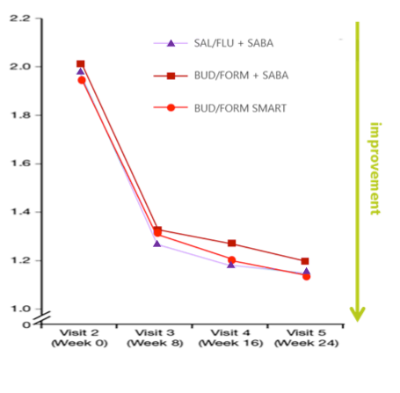
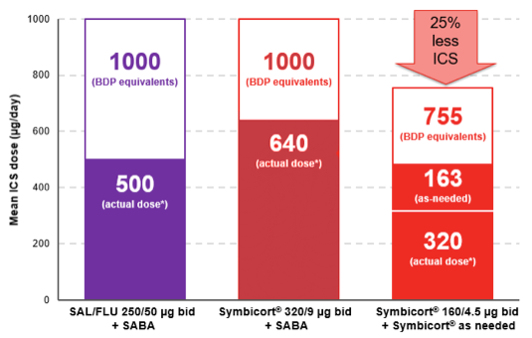
Budesonide/Formoterol (low-moderate dose) M&R reduces asthma exacerbations with a similar symptom control and at a lower ICS dose compared to ICS/LABA (low-moderate dose) + SABA¹
BEYOND GOAL & FACET
COMPASS study results
Current control
Future risk
Overall ACQ score
Severe exacerbation reduction
ICS dose comparison
Mean ICS dose (µg/day)
Kuna P et al. Int J Clin Pract 2007; 61: 725-36
ACQ= Asthma Control Questionnaire

Slide 15
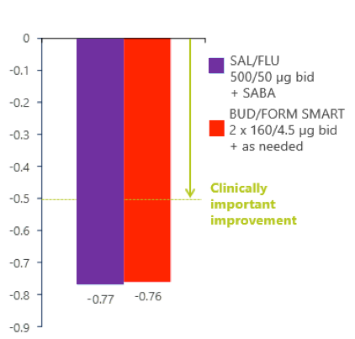
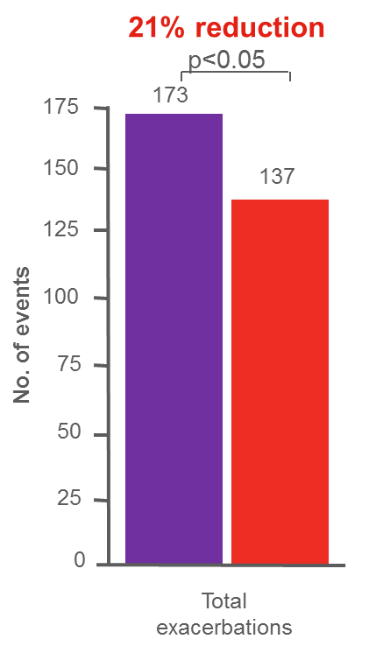
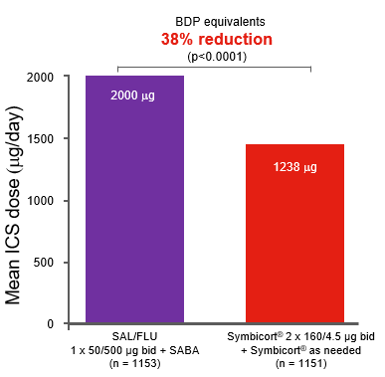
Budesonide/Formoterol (high dose) M&R reduces asthma exacerbations with a similar symptom control and at a lower ICS dose compared to ICS/LABA (high dose) + SABA¹
BEYOND GOAL & FACET
AHEAD study results
Current control
Future risk
Change in ACQ- score from run-in
Severe exacerbation reduction
ICS dose comparison
Bousquet J, et al. Respir Med 2007; 101:2437-2446

Slide 16
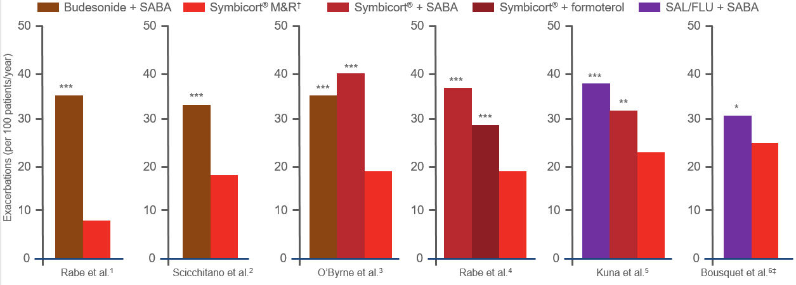
Symbicort M&R reduces the risk of severe exacerbations vs comparator therapies
BEYOND GOAL & FACET
The Symbicort M&R clinical trials program
*P = 0.039 vs. Symbicort®†; **P = 0.0048 vs. Symbicort®†; ***P < 0.001 vs. Symbicort®†
†Symbicort® maintenance and reliever therapy; ‡This study did not achieve its primary endpoint (time to first severe exacerbation)^{6 ;} SABA, short-acting β₂-agonist; SAL/FLU, salmeterol/fluticasone.
STEAM
STEP
STAY
SMILE
COMPASS
AHEAD
1. Rabe KF, et al. Chest 2006;129:246–256; 2. Scicchitano R, et al. Curr Med Res Opin 2004;20:1403–1418; 3. O’Byrne PM, et al. Am J Respir Crit Care Med 2005;171:129–136; 4. Rabe KF, et al. Lancet 2006;368:744–753; 5. Data on file, not in main publication (Kuna P, et al. Int J Clin Pract 2007;61:725–736); CSR SD-039-0735, table 17, footnote; data extrapolated from 6 mo data; 6. Bousquet J, et al. Respir Med 2007;101:2437–2446.

Slide 17
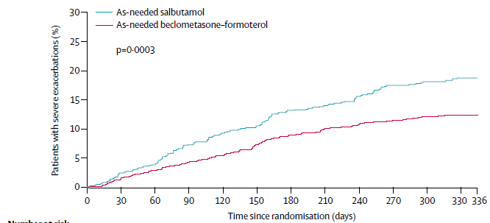
Beclometasone/formoterol MART was assessed in one study¹ in which it reduced the rate of severe exacerbation at a superior total ICS dose vs beclometasone/formoterol + SABA
BEYOND GOAL & FACET
The PAPI study¹
Severe exacerbation reduction
ICS dose comparison
Beclometasone-formoterol 100/6 μg bid. + salbutamol 100 μg as needed Beclometasone-formoterol 100/6 μg bid. + as needed
“The reduction in exacerbation rate with beclometasone–formoterol as maintenance and reliever could be due to the additional dose of beclometasone extrafine (86 μg/day)
taken by patients in this group”
-34%
Papi et al. Lancet Respir Med. 2013 Mar;1(1):23-31

Slide 18
Context
The GOAL and FACET studies findings
Beyond GOAL and FACET
Airway remodelling
Conclusion
Discussion

Slide 19
ICS/LABA M&R therapy and airway remodelling¹
AIRWAY REMODELLING
As the use of ICS/LABA for both maintenance and relief may lead to a reduction in the dose of ICS required to maintain stable disease, concerns have been raised that this approach may reduce the frequency of exacerbations without controlling airway remodelling.
In a 12-month, parallelgroup, randomised study, patients were treated with budesonide/formoterol maintenance and reliever therapy (160/4.5 µg bd) or both budesonide/formoterol (320/9 µg bd) and budesonide (320 µg bd) plus SABA in order to determine if the lower maintenance dose of budesonide used in the maintenance and reliever therapy approach had an effect on airway remodelling.
Budesonide/formoterol maintenance and reliever therapy reduced airway remodelling as effectively as the high dose of budesonide/formoterol plus SABA, as indicated by the lack of between-group differences in reduction of reticular basement membrane thickness over 12 months.
Pavord et al., J. Allergy Clin. Immunol. 2009; 123: 1083-1089

Slide 20
Context
The GOAL and FACET studies findings
Beyond GOAL and FACET
Airway remodelling
Conclusion
Discussion

Slide 21
ICS/LABA M&R therapy allows prevention of current control & future risk
Conclusion
There is a large body of evidence to show that treatment with budesonide/formoterol maintenance and reliever therapy improves both current control and future risk compared with ICS/LABA plus SABA or a higher dose of budesonide alone.

Slide 22
Context
The GOAL and FACET studies findings
Beyond GOAL and FACET
Airway remodelling
Conclusion
Discussion

Slide 23
There is an unmet need for improved understanding and attainment of asthma control
Discussion
REALISE study (N=8,000)
45.1%
of patients had GINA-defined uncontrolled asthma
(n=3,611)
The REALISE study demonstrated a large gap between patients’ perception of asthma control, and the clinical reality of asthma control.
83.7%
of these patients perceived their asthma as controlled
(n=3,023)
69.9%
of these patients perceived their asthma as not serious
(n=2,523)
The REALISE survey was conducted in patients aged 18–50 years who were active on social media.
Price D, et al. NPJ Prim Care Respir Med. 2014;24:14009

Slide 24
Asthma control is poor across disease severity
Discussion
Asthma control according to treatment step (n = 624)¹
In the MAGIC study of patients with physician-diagnosed asthma (N = 1286), the incidence of uncontrolled asthma increased with increasing GINA* Steps 2–5¹.
Asthma control was poor, even at GINA Step 1¹.
 | Step 1 | Step 2 | Steps 3&4 | Step 5
 | 2006 GINA treatment step²
Reliever | As-needed SABA
Controller |  | Low dose ICS | ICS/LABA | ICS/LABA plus Oral GCS or Anti-IgE
*Based on 2006 GINA guidelines².
GINA, Global Initiative for Asthma; GCS, glucocorticoids; ICS, inhaled corticosteroid; IgE, immunoglobulin E; LABA, long-acting β2-agonist; SABA, short-acting β2-agonist.
1. Olaguibel JM et al. Respir Res 2012, 13: 50; 2. Bateman ED, et al. Eur Respir J 2008; 31: 143–78.

Slide 25
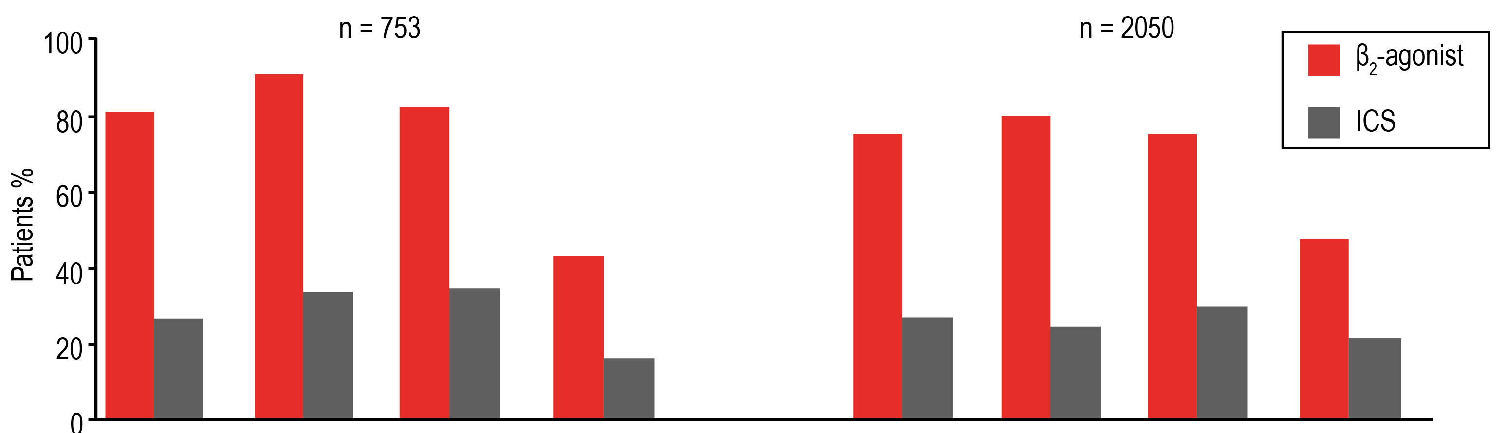
Over-reliance on SABA occurs in children and adults and is irrespective of asthma severity
Discussion
Medicines used to treat asthma by Symptoms Severity Index:
Anti-inflammatories versus quick-relief medications
In the AIRE survey, ~3 times more patients had used quick-relief medication (63%) than maintenance medication (ICS) (23%) over a 4-week period.
Severe Persistent
Moderate Persistent
Mild Persistent
Mild Intermittent
Severe Persistent
Moderate Persistent
Mild Persistent
Mild Intermittent
ICS, inhaled corticosteroid; SABA, short-acting β2-agonist; SP, severe persistent.
Rabe KF et al. Eur Respir J 2000; 16: 802–7.

Slide 26
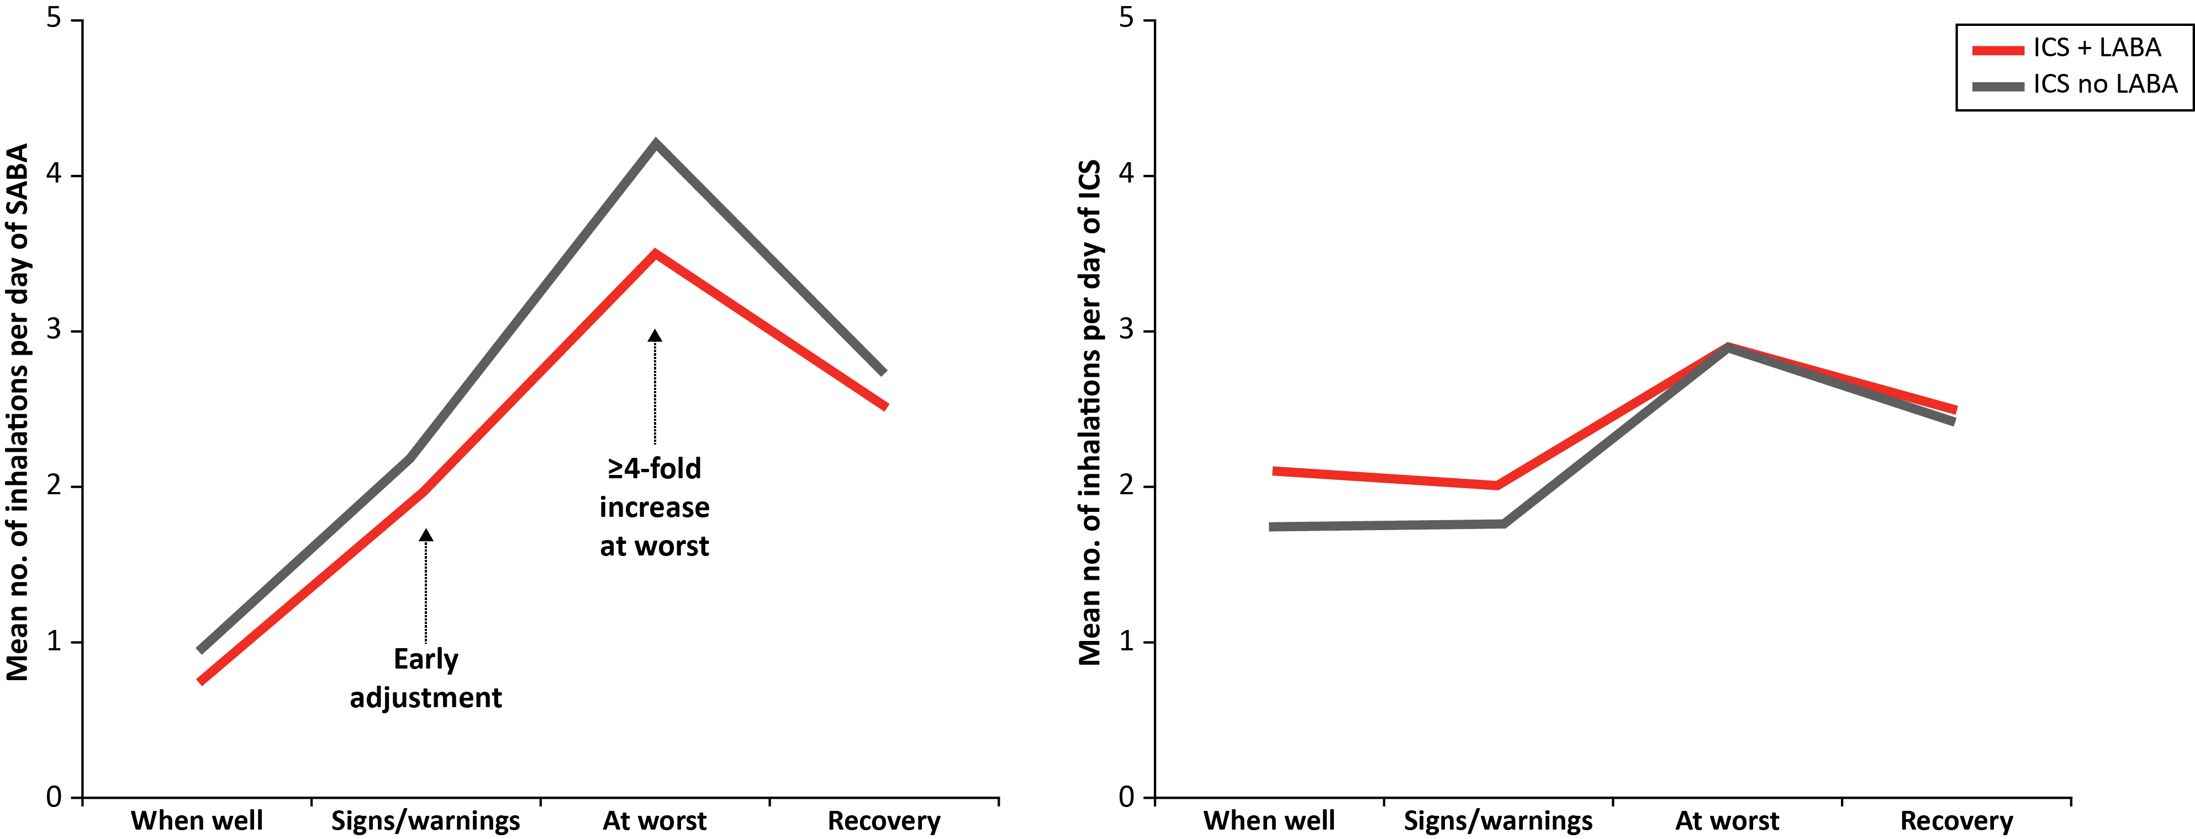
INSPIRE: During symptom worsening, patients rely on their SABA immediately but delay taking additional preventer medication.
Discussion
Stages of symptom worsening
n = 3,411
Figures adapted from: Partridge MR et al. 2006
ICS, inhaled corticosteroid; LABA, long-acting β₂-agonist; SABA, short-acting β₂-agonist.
Partridge MR et al. BMC Pulm Med 2006; 6:13

Slide 27
NRAD report reveals excessive prescribing of SABAs and under-prescribing of preventer medication
Discussion
The NRAD report was an investigation of recent asthma deaths in the UK by the Royal College of Physicians
Evidence of excessive prescribing of reliever medication
Evidence of under-prescribing of preventer medication
39%
of patients who were on short-acting relievers at the time of death had been prescribed more than
To comply with recommendations, most patients would usually need at least
12 preventer prescriptions per year
12 short-acting reliever inhalers in the year before they died
4% had been prescribed more than
38% of patients on preventer inhalers* received fewer than 4 inhalers in the year leading up to their death…
50
reliever inhalers
and 80% received fewer than 12 preventer inhalers
*Of those patients for which the number of prescriptions was known. Among 189 patients who were on short-acting relievers at the time of death, the number of prescriptions was known for 165. Among 168 patients on preventer inhalers at the time of death, either as stand-alone or in combination, the number of prescriptions was known for 128.
NRAD, National Review of Asthma Deaths; SABA, short-acting β₂-agonist Royal College of Physicians. Why Asthma Still Kills? The National Review of Asthma Deaths (NRAD) [online] 2014. Available from: https://www.rcplondon.ac.uk/projects/outputs/why-asthma-still-kills [Last accessed: December, 2016].

Slide 28
Over-reliance on SABA and under-use of ICS are both associated with an increase in mortality
Discussion
Over-reliance on SABA at the expense of ICS controller therapy is associated with an increased risk of asthma-related death, as a result of under-treatment of inflammation¹
Episodes of high reliever use (>6 inhalations/day on at least one day) are also predictive of an increased risk of exacerbations³
2.5
250
200
2.0
150
1.5
Rate ratio for death from asthma
Asthma deaths/10,000 patient-years
100
1.0
50
0.5
0.0
0.0
0
1
2
3
4
5
6
7
0
1
2
3
4
5
6
7
8
9
10
11
12
Canisters of SABA per month/20,000 μg¹
Canisters of ICS per year²
ICS, inhaled corticosteroid; SABA, short-acting β₂-agonist.
1. Suissa S et al. Am J Respir Crit Care Med 1994; 149: 604–10; 2. Suissa S et al. N Engl J Med 2000; 343: 332–6; 3. Buhl R et al. Respir Res 2012; 13: 59

Slide 29
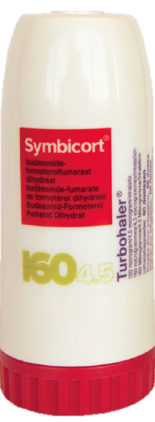
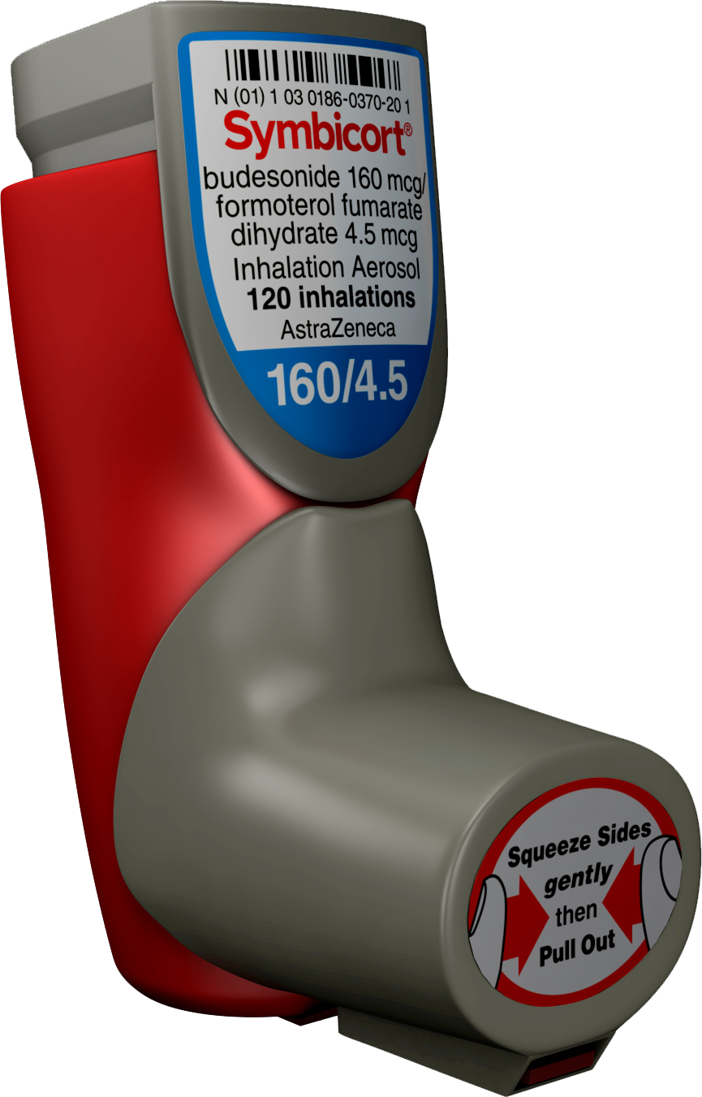
Discussion
Maintenance & reliever therapy as of 12 years old#
COPD: Symbicort available in Turbohaler or pMDI*
Available in Triple Pack#
SmPCs: Symbicort Turbohaler (160/4,5), Symbicort Turbohaler (320/9), Symbicort Aerosol(160/4,5) latest versions
* Symbicort aérosol-doseur is to be used in the treatment of COPD and is not approved within the EU for the treatment of asthma. Symbicort aérosol-doseur is not to be used as a reliever medication, thus obviating its use as maintenance and reliever therapy (ie, SMART). # Maintenance & Reliever therapy only in asthma for Symbicort Turbohaler (160/4,5)

Slide 30
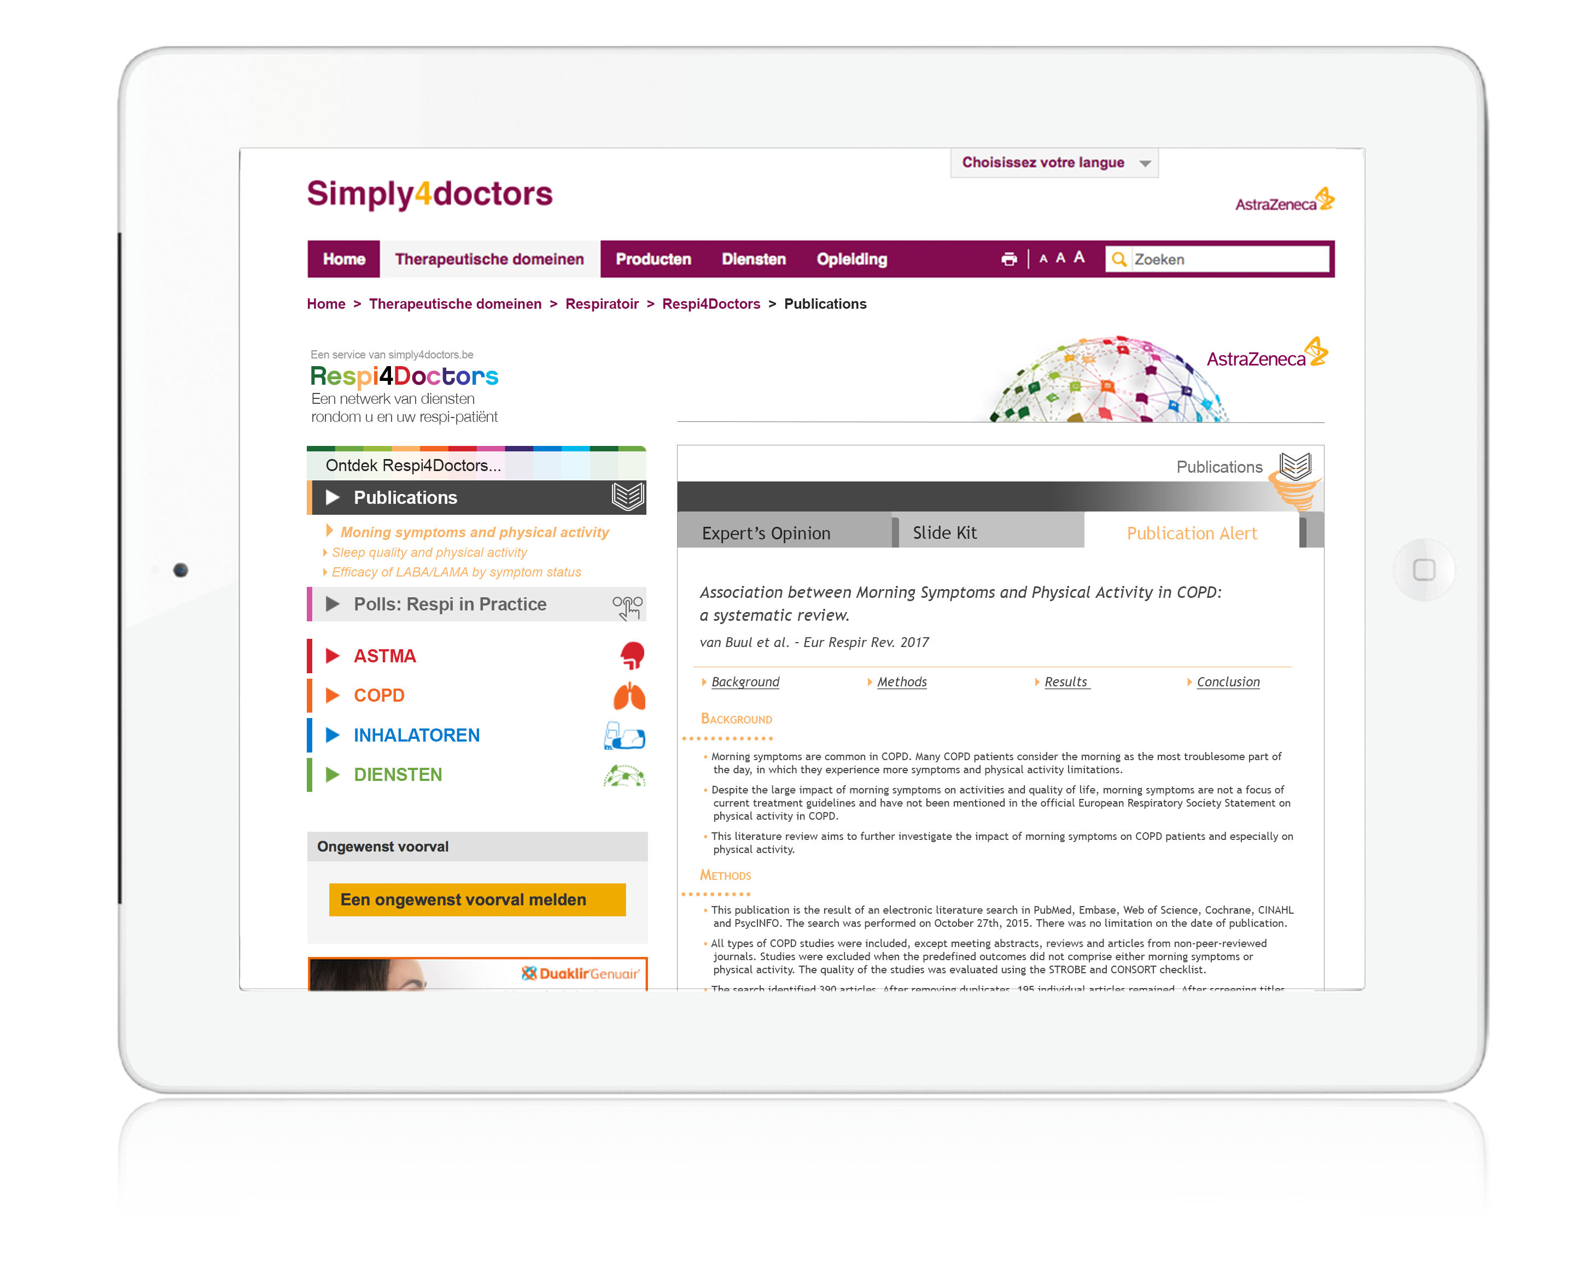
Want to be informed about
the latest scientific publications?
Subscribe to AZ Publication Alerts
Ask your rep for more information
NS ID XL-0208-RD12/2017-VA
Local code 1386

